Slide 1


DATA ANALYIS INTERNSHIP PROJECT
Pr
Prepared by K.R.MANIKANDAN
Submitted on 11th Sep 2024

Slide 2
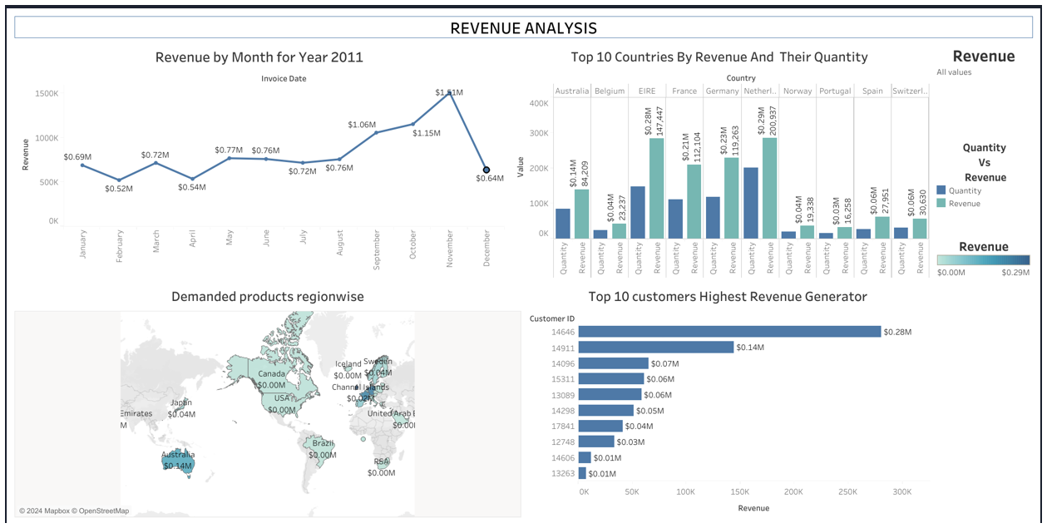
DASHBOARD MARKET ANALYSIS

Slide 3
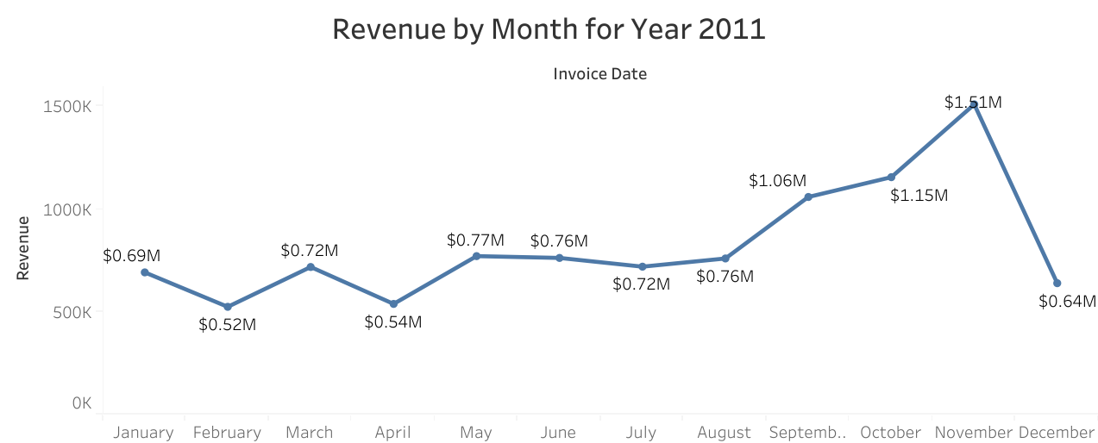
Time series Analysis
Highest Monthly Revenue is November $ 1.51M
Lowest Monthly Revenue is February $ 0.52M
CEO wants to know the Revenue of 2011 for each month, seasonal trends identified for future forecasting . Time series analysis done. In the month of August to November Revenue increasing November is highest. February is lowest.

Slide 4
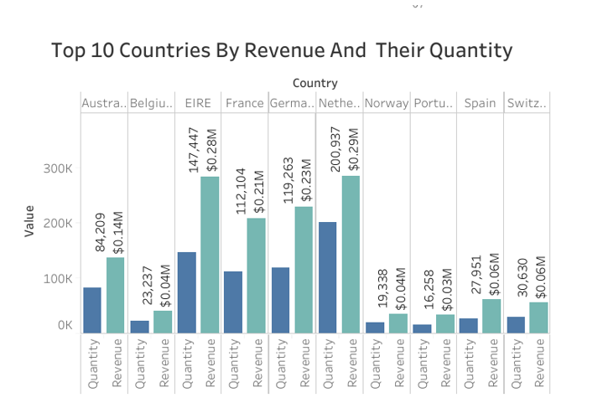
Revenue and quantity Analysis
Highest Revenue generated country is Netherland
$ 0.29 M
Lowest Revenue generated country is Portugal
$ 0.03 M
CMO wants to know the Revenue of year 2011 , generated by the top 10 countries with quantity and exclude potential country UK from this analysis . Revenue and quantity compared by Bar charts Netherland is highest revenue generated country with quantity. Portugal generated the least revenue.

Slide 5
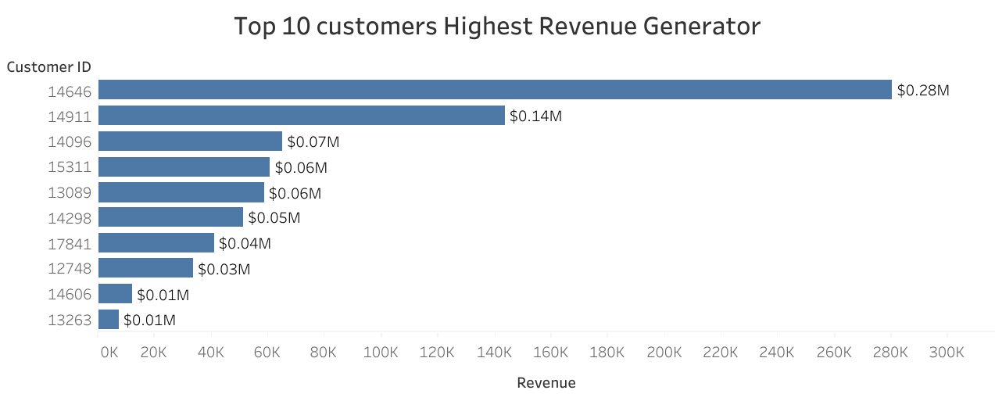
Customer Analysis
Highest Revenue generated coustomer ID is 14646
$ 0.28 M
CMO wants to know the Revenue of year 2011 (exclude Uk since having potential market),
top 10 highest revenue generated customers to prepare the customer satisfaction strategy for keep retain the customers.

Slide 6
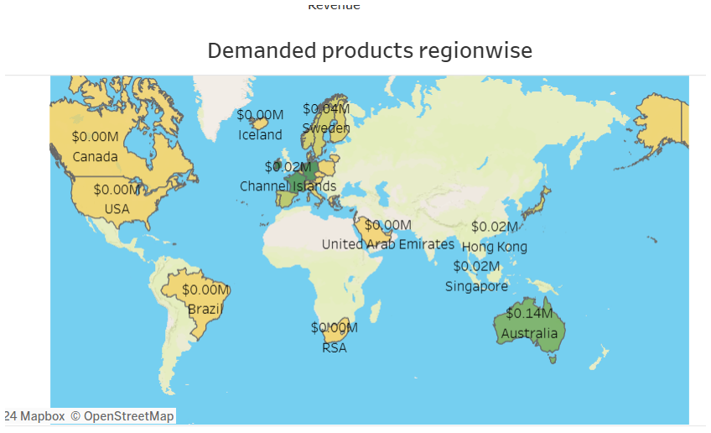
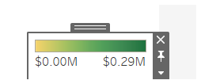
Product Vs Regional Analysis
Highest Revenue generated Region Australia
CEO wants to know the Revenue of year 2011 regionalwise per product (exclude Uk since having potential market),to plan the strategy for expand the business. Asia, African countries business need to be expandable. Keep the momentum of sales by cutomer satisfaction and more products launch in European and US market.

